Slide 1
0x104 – What is Computer Safety?
ECED4406 – Computer Security
Dr. Colin O’Flynn
Dalhousie University.

Slide 2
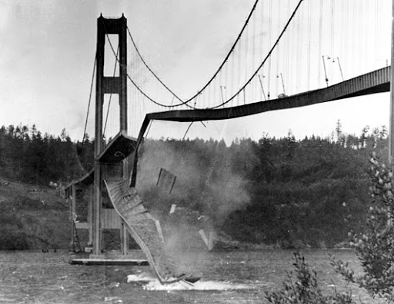
Let’s Look at Failures

Slide 3
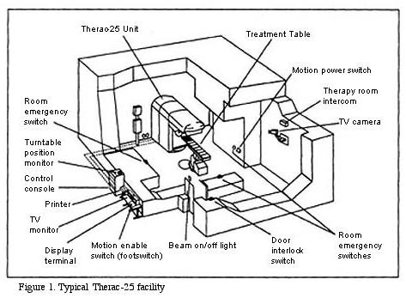
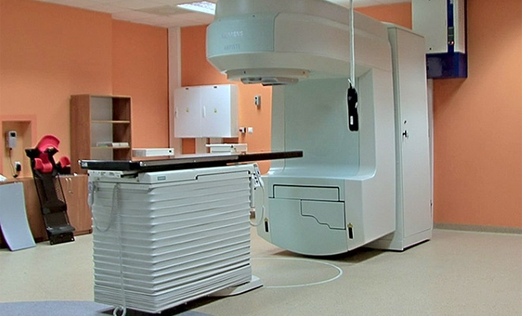
Failure #1 - Therac-25
https://hackaday.com/2015/10/26/killed-by-a-machine-the-therac-25/
https://en.wikipedia.org/wiki/Therac-25
https://www.computer.org/csdl/magazine/co/2017/11/mco2017110008/13rRUxAStVR

Slide 4
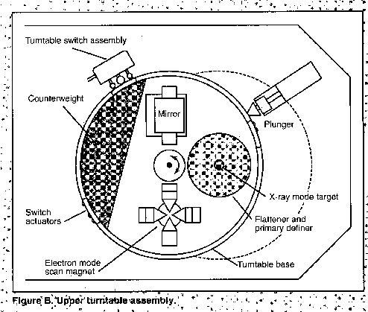
Therac-25 Quick History
New “Revolutionary” machine could deliver radiation in two modes:
Electrons (low-energy, good for attacking shallow tissue such as skin cancer).
X-Ray (high-energy, attacking deeper tissue such as lung cancer).
Turn-table rotates to insert into beam path.

Slide 5
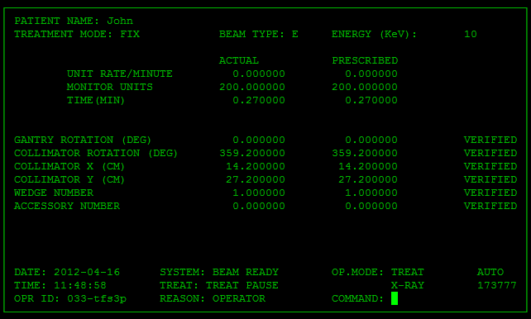
Therac-25 User Interface

Slide 6
Therac-25 User Cost
Six documented accidents where incorrect beam or energy delivered.
In three cases patients died as a result of radiation.

Slide 7
Examples of Code Issues
Hardware safety switches from previous versions were now done purely in software.
Errors gave simple code # errors (‘MALFUNCTION 53’) without explaining what that meant. Operators got accustomed to just continuing because they came up frequently.
Even critical errors could be ‘skipped’ by this process.

Slide 8
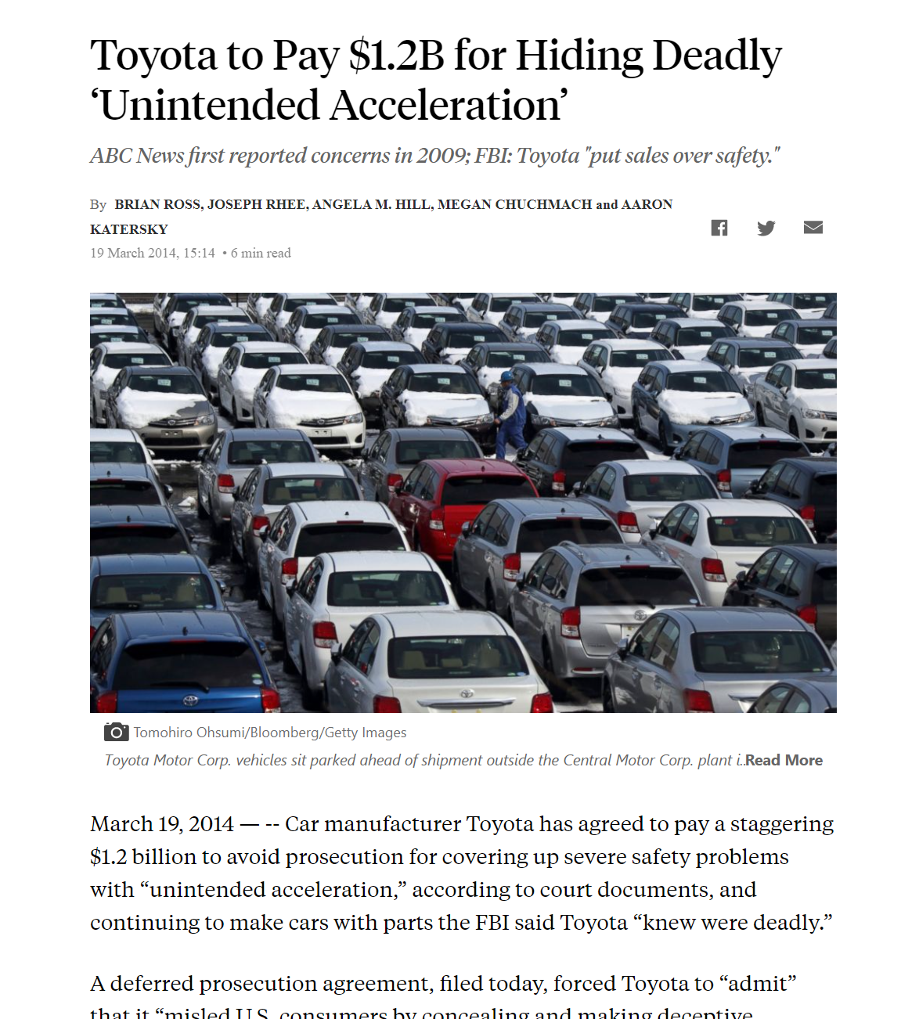
Failure #2 – Toyota Unintended Acceleration
https://abcnews.go.com/Blotter/toyota-pay-12b-hiding-deadly-unintended-acceleration/story?id=22972214
Small note – there is (for unknown reasons) many popular incorrect claims about this case I won’t go into. Many are a result of people being unclear about how automotive systems work or performing tests incorrectly. Vehicles rely on vacuum system to provide braking power assist – on “true” full throttle brake assist is lost. Many cars back off from full throttle during braking to keep your power brakes working, but the vehicles in question do not do this. If you have used a car which looses power brakes it is a very hard pedal (you can turn a car off to experience this).

Slide 9
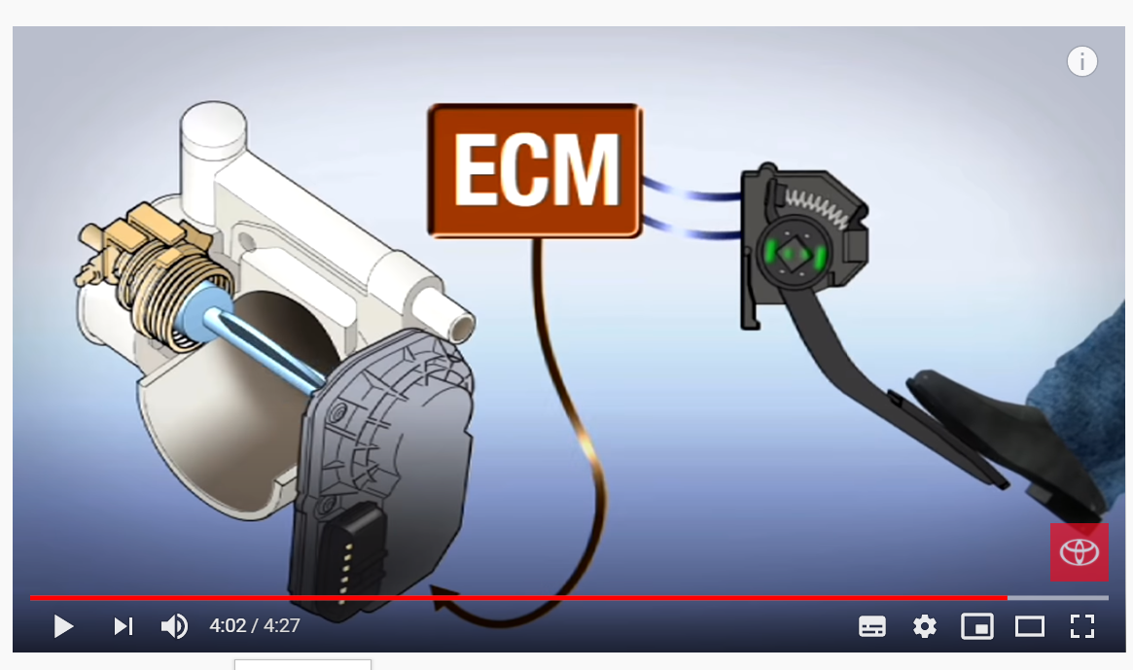
How does a Throttle Position Work
https://www.youtube.com/watch?v=Fn_cDN56Oy8S

Slide 10
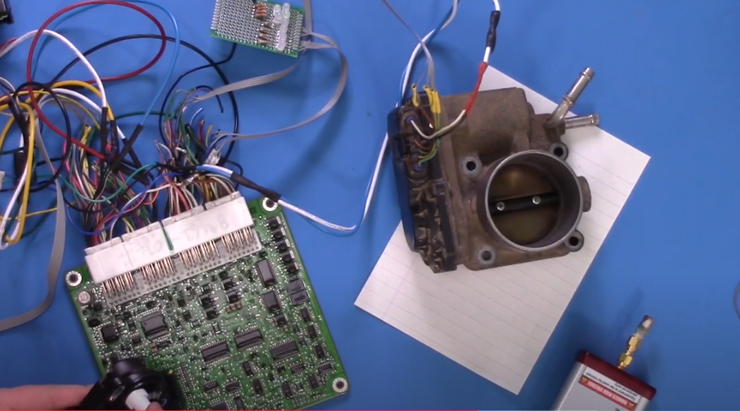
How does it NOT work?
https://www.youtube.com/watch?v=26yulQc-7XM

Slide 11
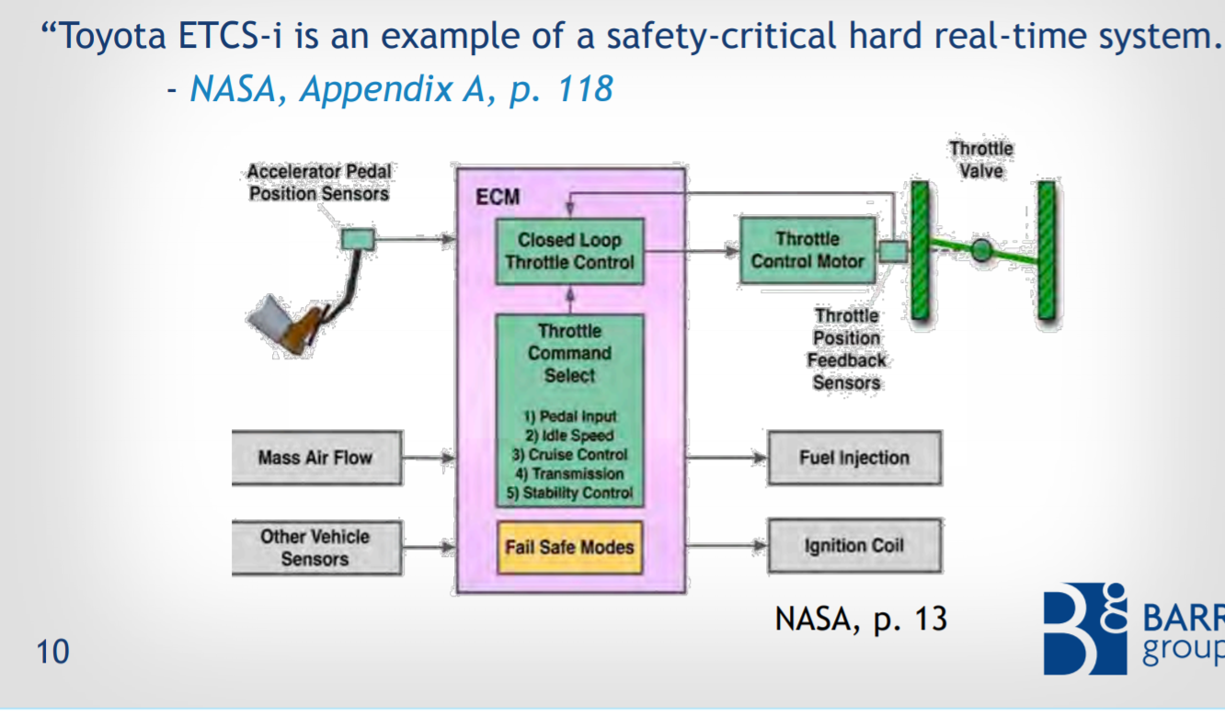
How could this happen?
More Details: https://www.safetyresearch.net/Library/BarrSlides_FINAL_SCRUBBED.pdf

Slide 12
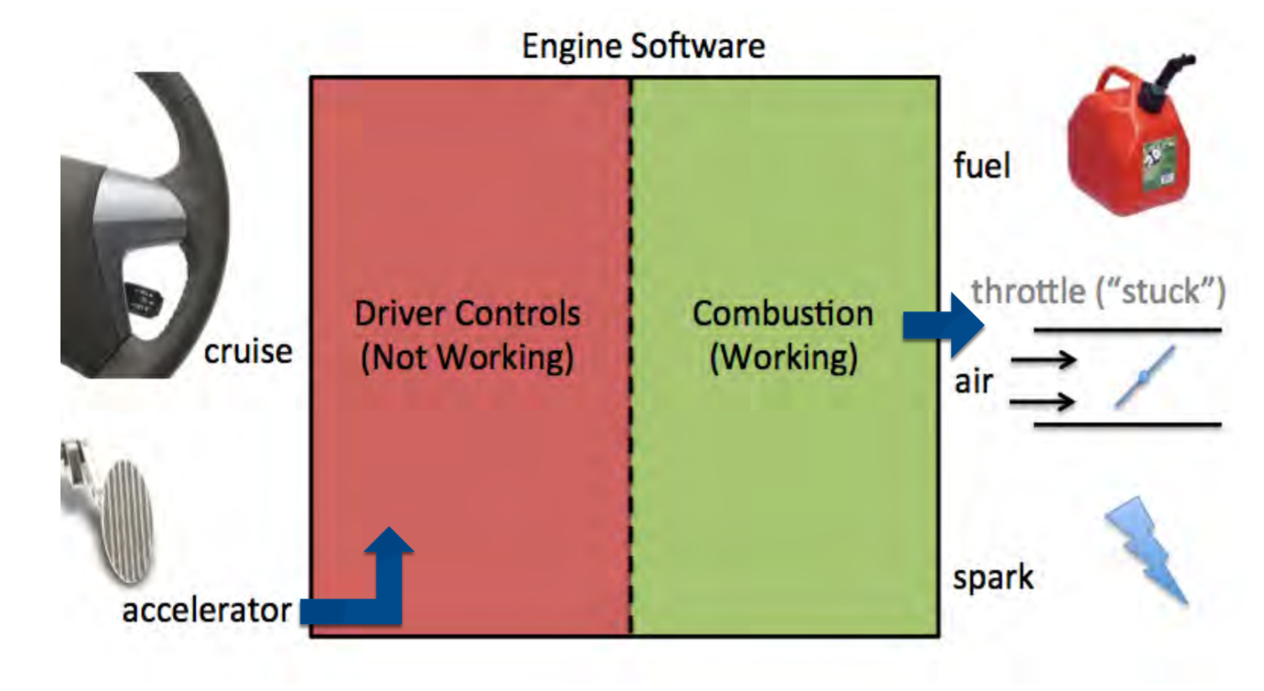
Example of Two Tasks – One Dies?

Slide 13
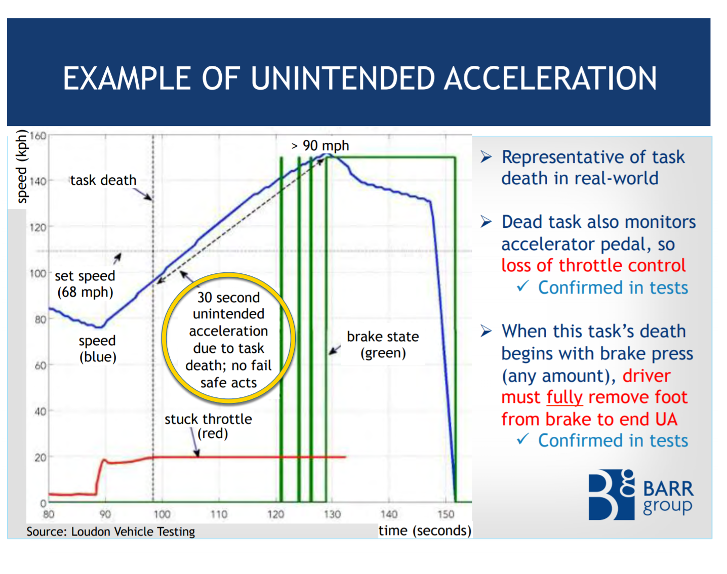
Testing…

Slide 14
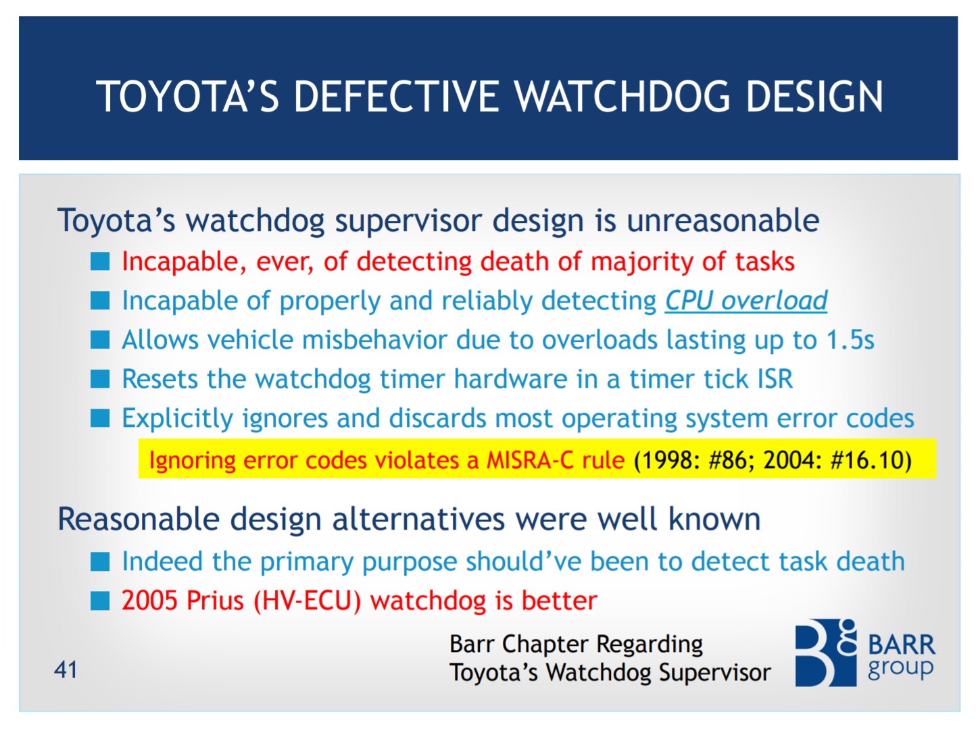
Huge number of failures…
See Barr’s presentation (linked earlier) for list of… many many things like:
Code which has complex connections and cannot be tested.
Fail-safes that don’t fail.
Unsafe memory usage.

Slide 15
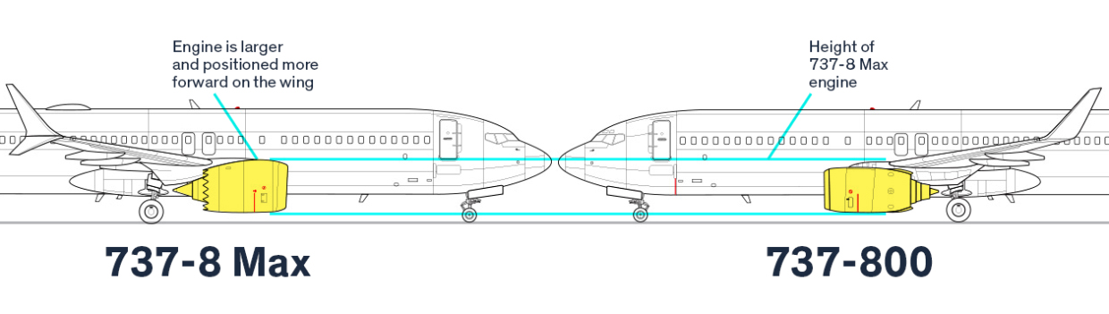
Failure #3 – 737 Max 8
https://spectrum.ieee.org/aerospace/aviation/how-the-boeing-737-max-disaster-looks-to-a-software-developer

Slide 16
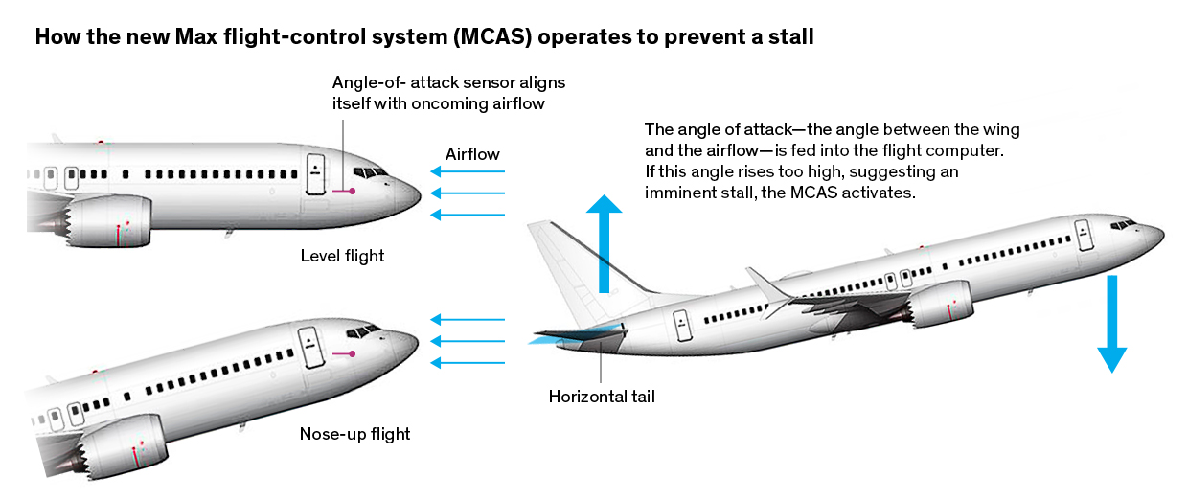
Fixing the “Engines Now Unstable” Problem… in software!

Slide 17
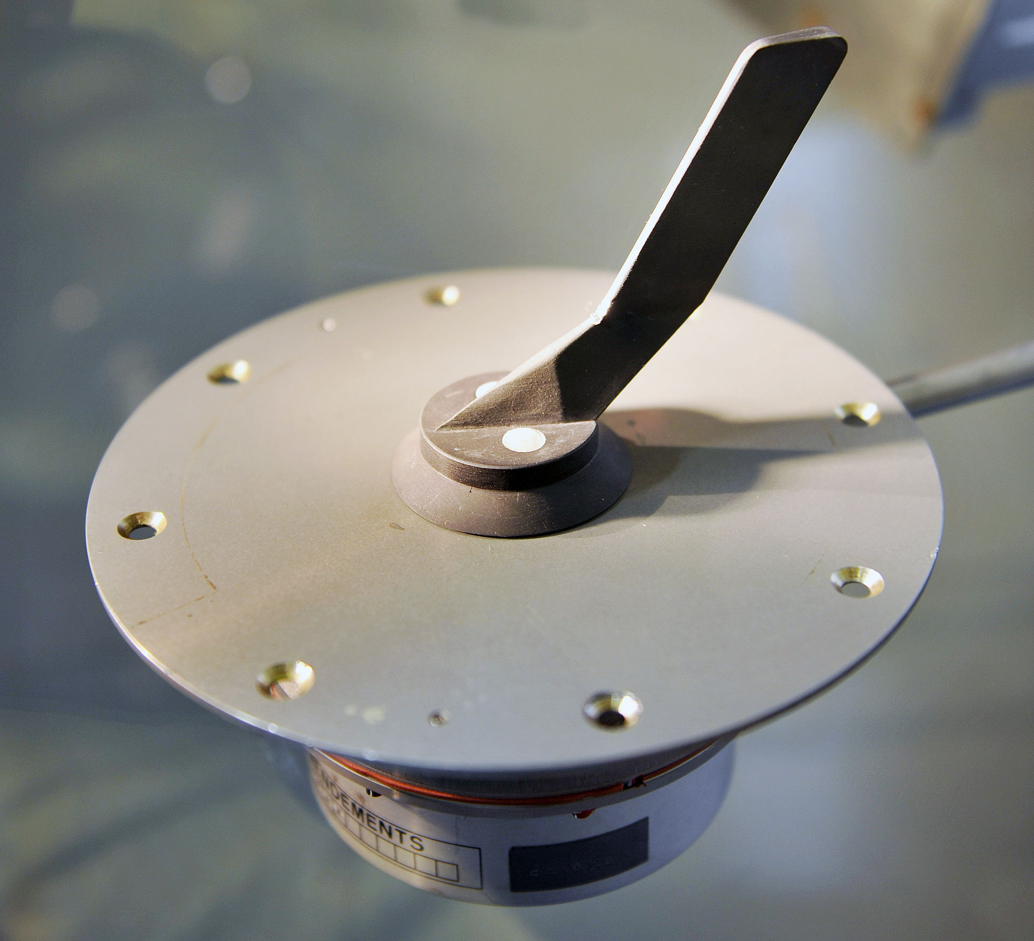
Angle of Attack Sensors…
x1 used by MCAS??
Aircraft actually have multiple – but possibly they are not used in a redundant manner it appears.
https://www.seattletimes.com/business/boeing-aerospace/a-lack-of-redundancies-on-737-max-system-has-baffled-even-those-who-worked-on-the-jet/
https://en.wikipedia.org/wiki/Maneuvering_Characteristics_Augmentation_System

Slide 18
More Failures you can Research:
Ariane 5 rocket launch (https://www.bugsnag.com/blog/bug-day-ariane-5-disaster).
$370m cost (rocket go boom) - https://www.youtube.com/watch?v=N6PWATvLQCY&t=1m10s .
Cause – incorrect conversion of types (64 bit converted to 16-bit).
Mars Climate Orbiter (https://en.wikipedia.org/wiki/Mars_Climate_Orbiter)
$330m cost (orbiter lost).
Cause – incorrect internal unit conversion between systems.

Slide 19
Duty as an Engineer
Safety of public is always the most important thing as an engineer.
Previous examples all caused damage to public, all with various root causes:
Engineers who were not familiar with best practices.
Management pressure.
Engineers may be “blind” to how final system is used, keep head down to avoid trouble.

Slide 20
Designing Safe Computer Systems
This course isn’t about computer safety – at least another course in itself!
But we can fairly easily apply the basics of computer safety here.

Slide 21
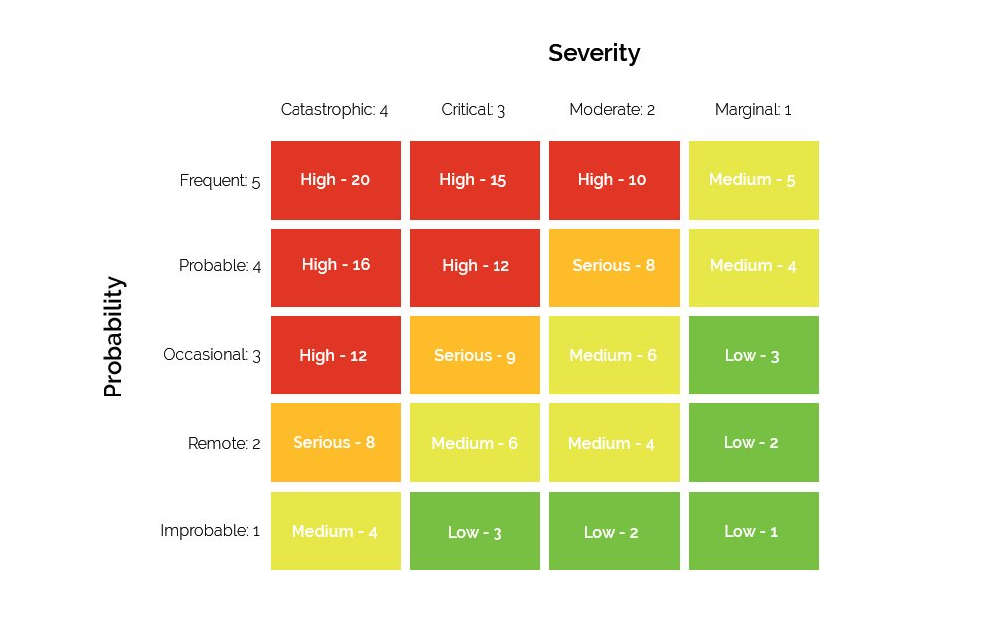
Generic Risk Matrix Thingy

Slide 22
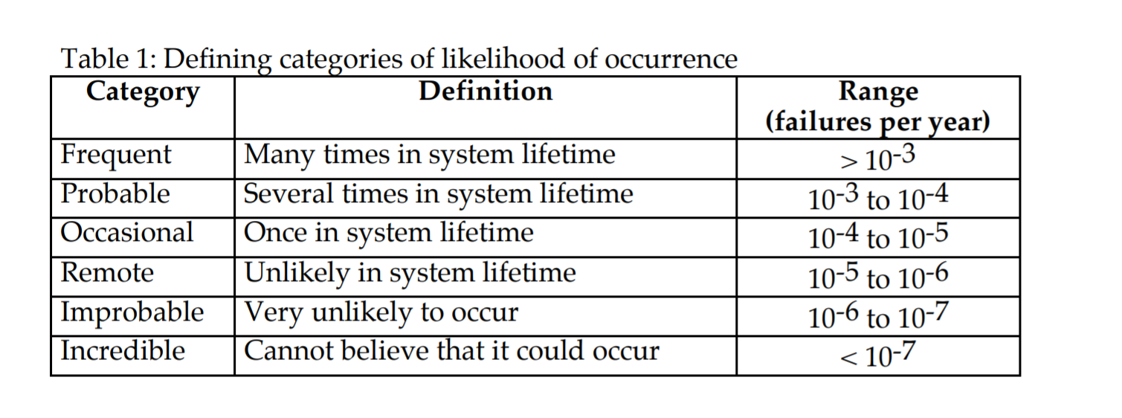
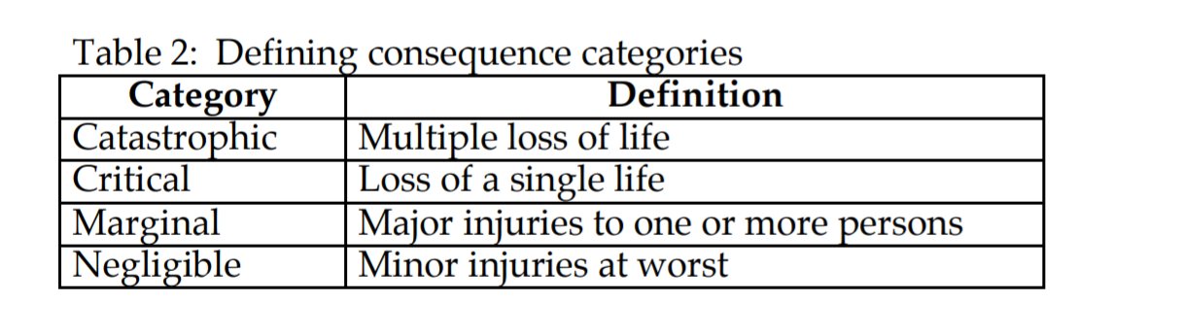
IEC 61508 – Functional Safety

Slide 23
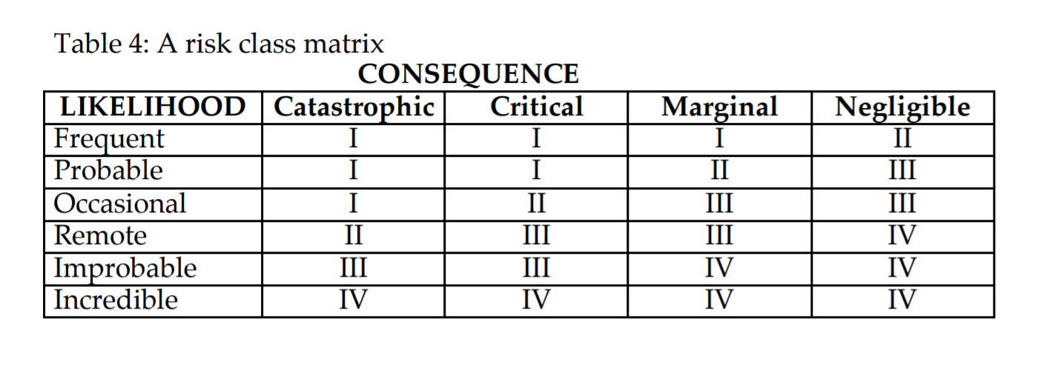
IEC 61508 – Functional Safety
Where:
Class I: Unacceptable in any circumstance;
Class II: Undesirable: tolerable only if risk reduction is impracticable or if the costs are grossly disproportionate to the improvement gained;
Class III: Tolerable if the cost of risk reduction would exceed the improvement;
Class IV: Acceptable as it stands, though it may need to be monitored.

Slide 24
Automotive & Other Standards
Many industries add their own standards, such as automotive which has ISO 26262.
MISRA project has rules known as “MISRA C” which specify certain things you can do to improve your C code.
NOTE: Colin called this ‘MIRSA C’ incorrectly in early revision of this.

Slide 25
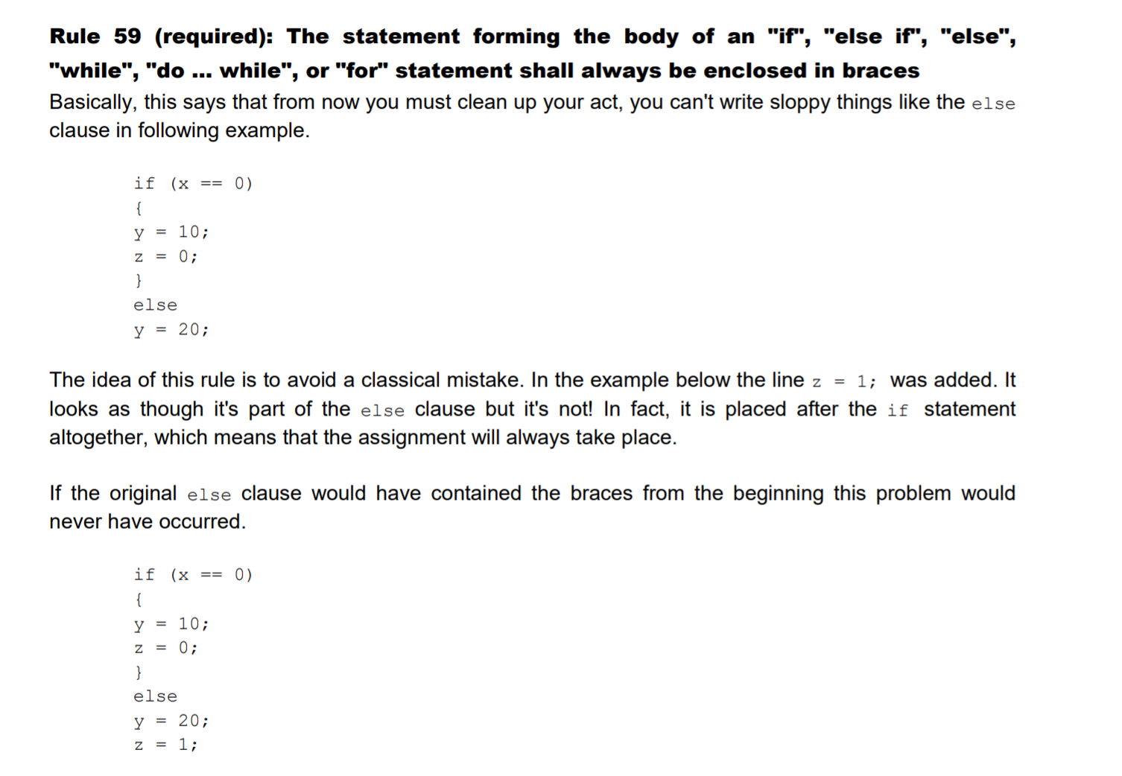
Example of MISRA C Code Rule

Slide 26
Problems with These “Standards”
How frequent are the errors in real life?
Therac-25 designers assumed it was user error.
Considerable $$$ spent on PR campaigns to assure everyone that Toyota unintended acceleration was a myth & due to users pressing wrong pedal (whether true or not – code in ECUs was horribly bad and should not have been allowed).
Errors that happen 1/100000 may happen a lot if you have 100000 units in the field…
What about hardware problems?

Slide 27
Aggressive Testing & Fuzzing
Code testing critical to truly catch errors.
But how good are your test? Do you just test correct & “expected incorrect” inputs?
We can use code fuzzing to help catch more errors.
Code fuzzing sends in incorrect data.
More on that in the next topic…

